Slide 1
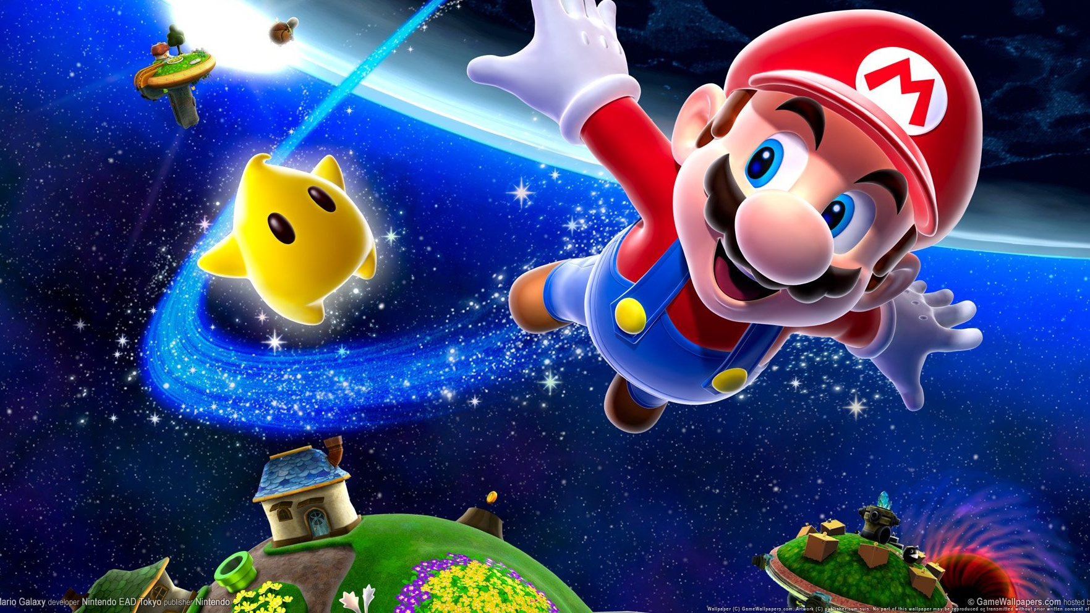
Three Games For Our Future
By: Rongbin Zhang, Haoyu Li & Tripuraneni JaganMohanChowdary

Slide 2
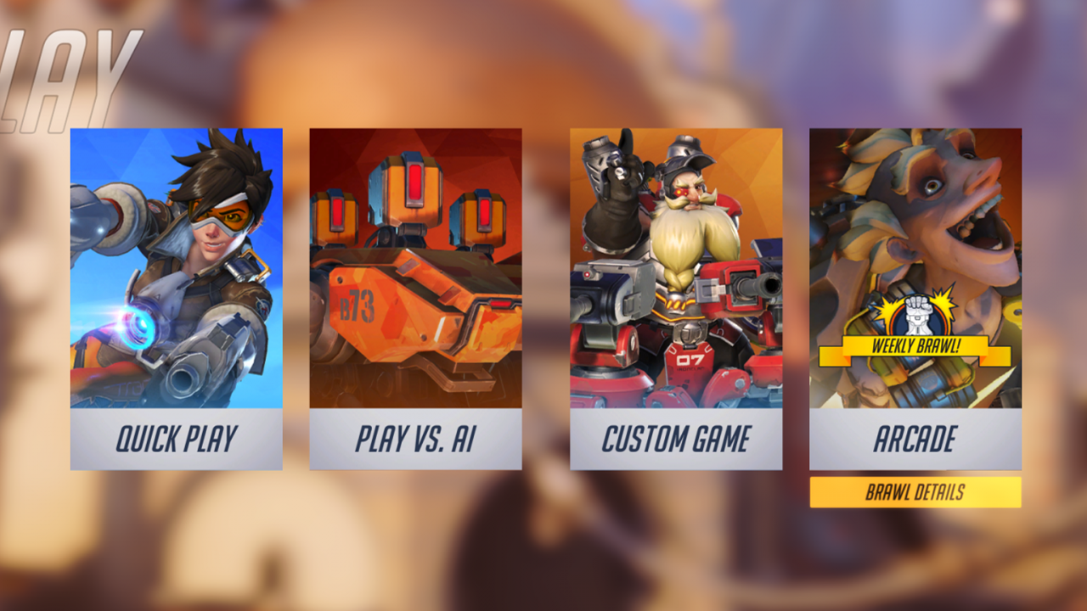
Table of Content
Introduction
Game for Japan
Game for Europe
Game for
North America

Slide 3

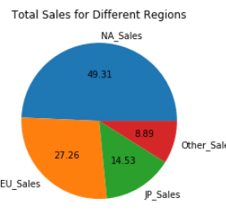
NLG Studios
NLG (Naughty Luigi Game)
3 Games for 3 main Regions
Japan, North America & Europe

Slide 4

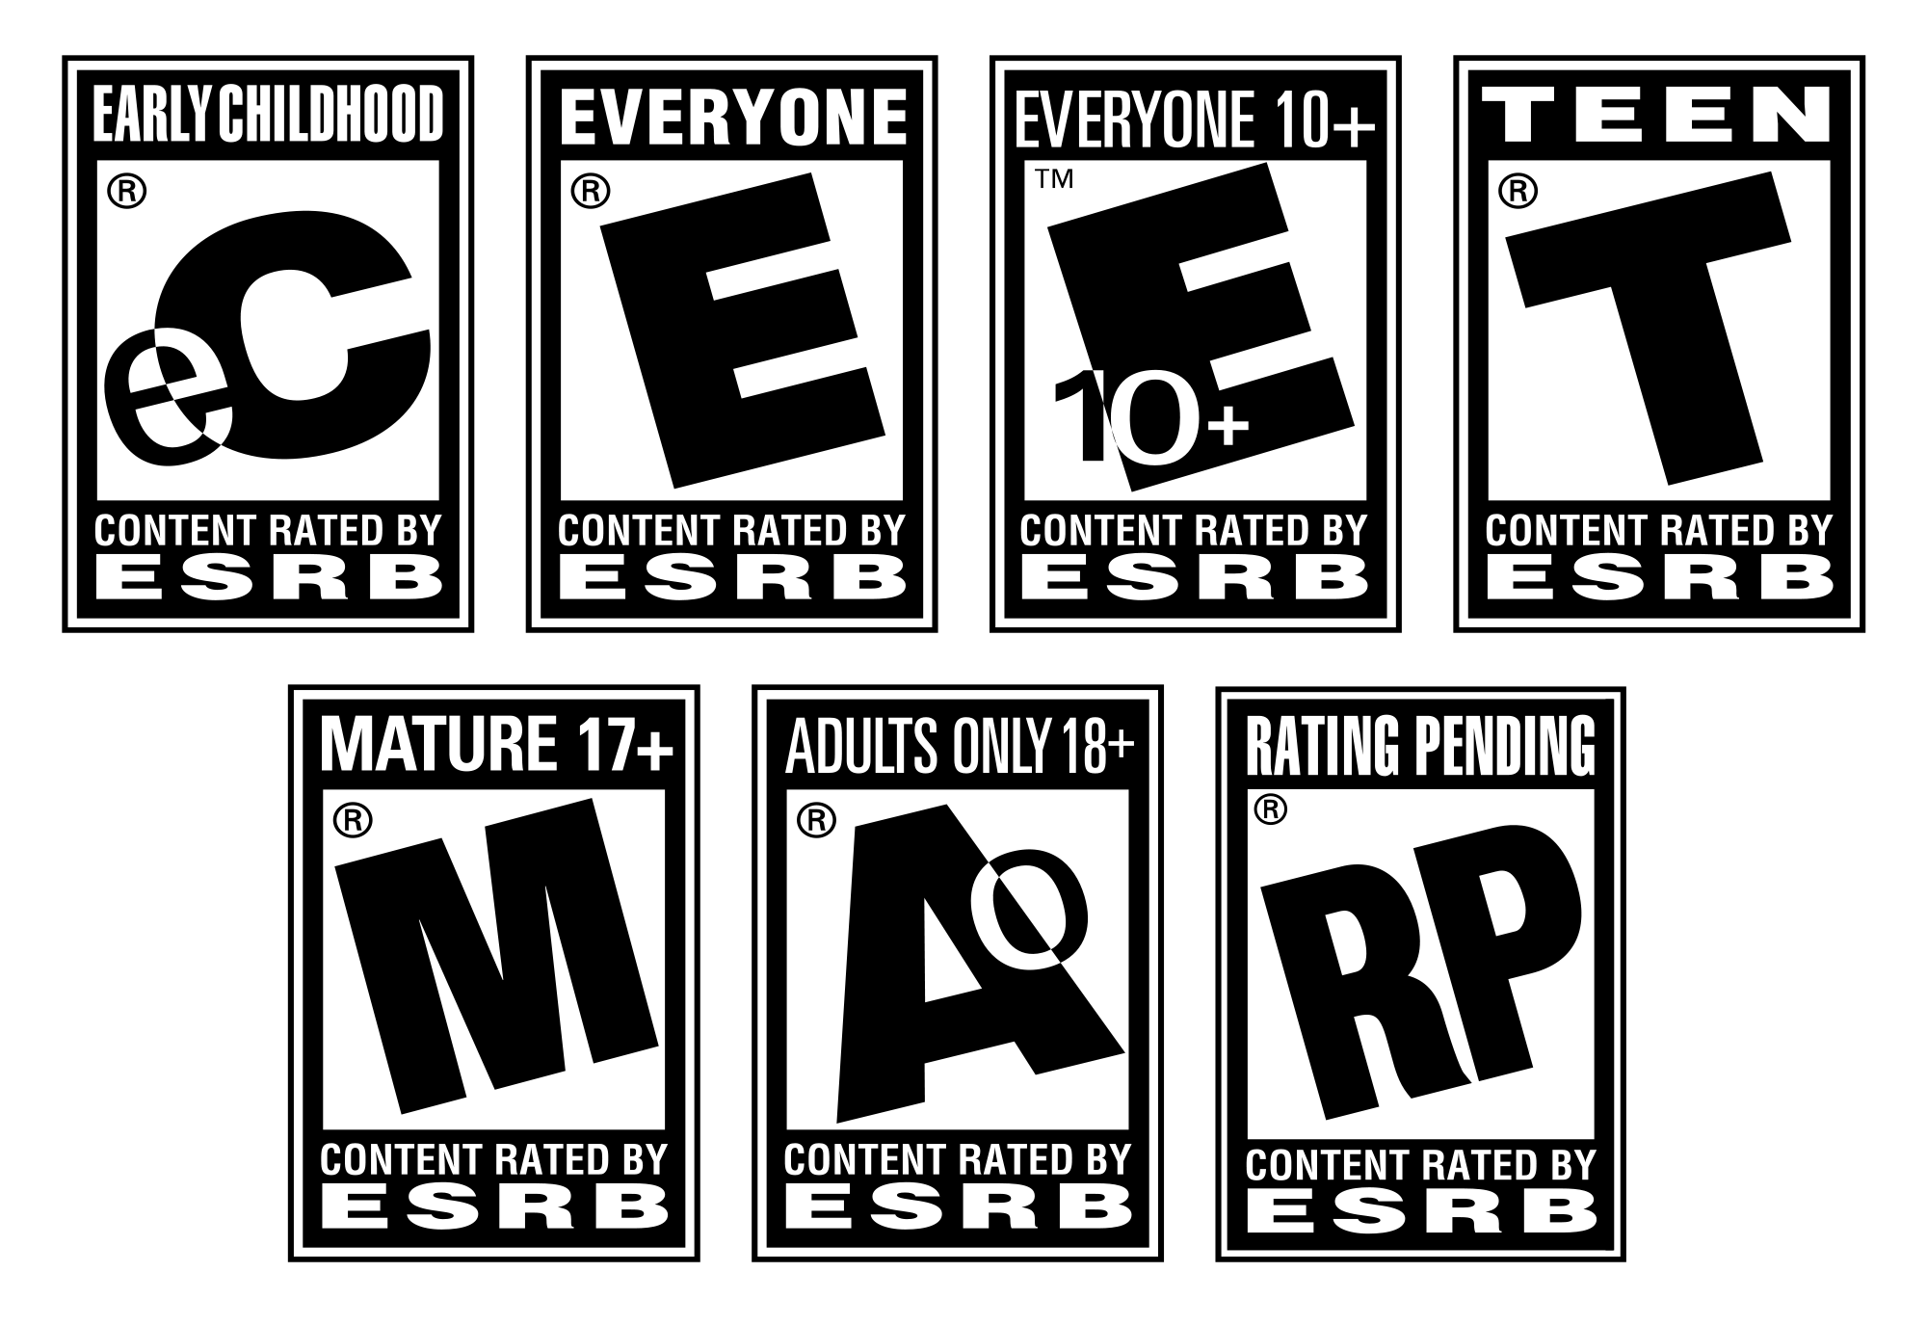
Before Diving to the Data...
User_score Column : Score by Metacritic's subscribers
User_count Column: Number of subscribers who gave the score
Rating Column : The ESRB(Entertainment Software Rating Board) ratings

Slide 5
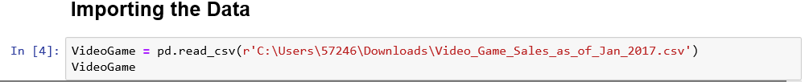

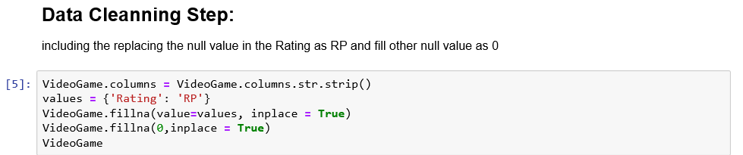
Data Import & Data Cleaning
Data Source (Video_Game_Sales_as_of_Jan_2017):
https://www.kaggle.com/kendallgillies/video-game-sales-and-ratings

Slide 6


Game for Japan

Slide 7
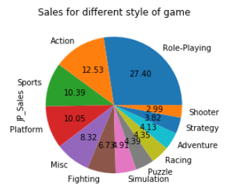
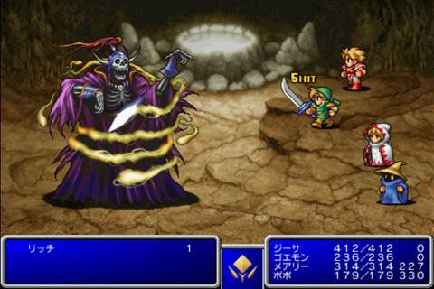
Style of Game
Role-Playing

Slide 8
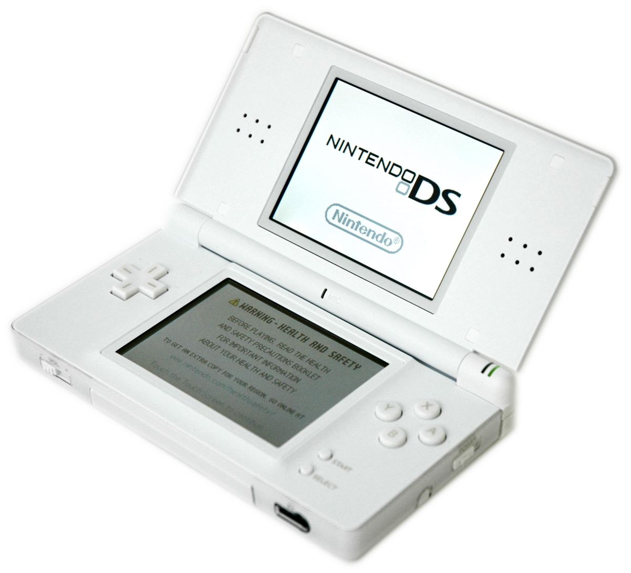
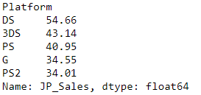
Which Platform? ---DS
Top 5 Platforms Sales for Role-Playing Game in Japan (In Million $)
“Nintendo DS games can still be played on the Nintendo 3DS family of systems.”

Slide 9
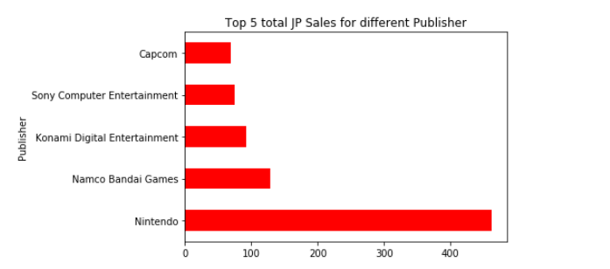
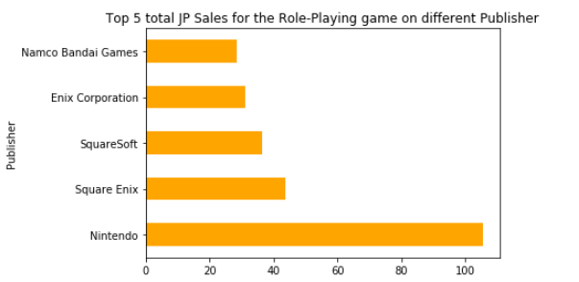

Game Publisher?
Nintendo

Slide 10
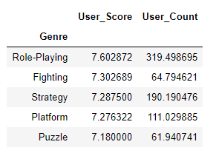
Target User Score
Average score for different kind of game (maximum point is 10)
Average number of users given the score in different style
8/10

Slide 11
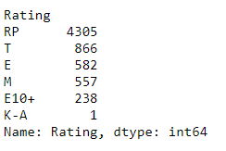

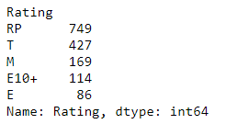
ESRB Rating?
Number of games in different ESRB Rating in Japan
Number of Role-Playing games for different ESRB Rating in Japan

Slide 12

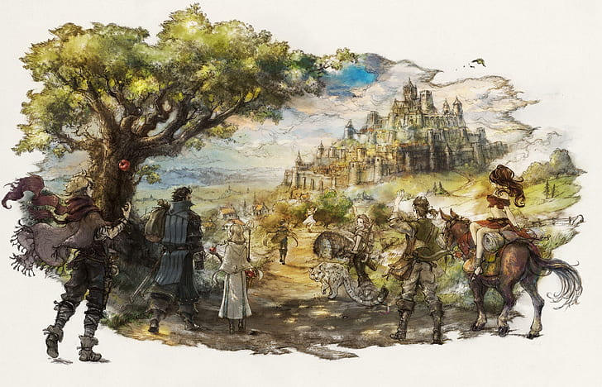
Game For Japan
Name: Fantasy Traveler
Style: Role-Playing
Platform: DS(3DS)
Publisher: Nintendo
ESRB Rating: T

Slide 13
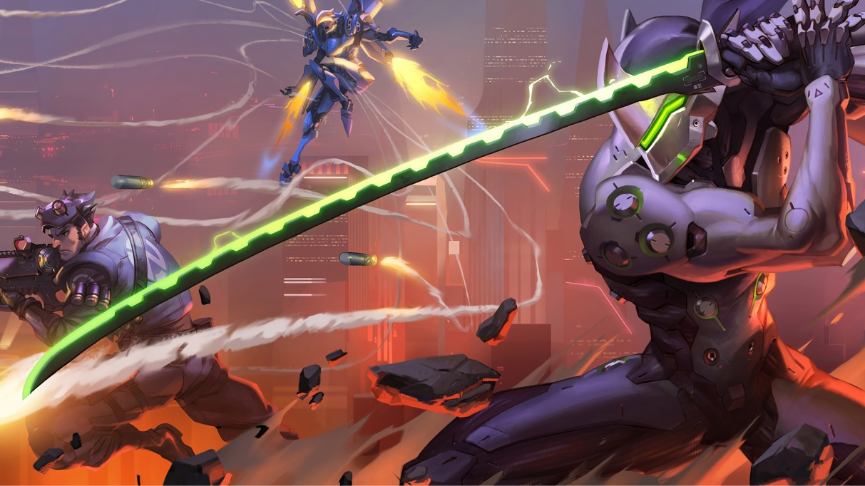
Game for Europe

Slide 14

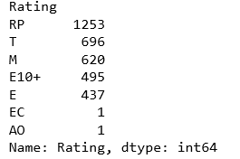
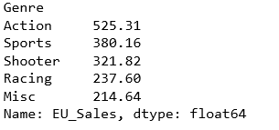
The Total EU Sales data for different kind of video games
(In Million)
The number of Action Games on different ESRB Rating
Game Category & ESRB Rating

Slide 15
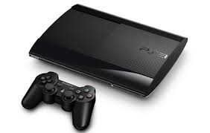
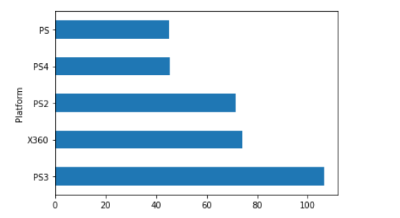
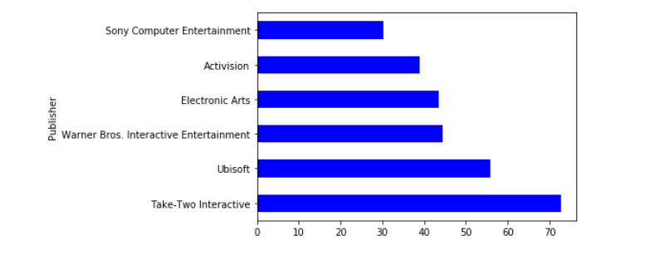

Top 5
platforms in EU
Top 6
Action Games publishers
Welcome platforms & publishers in EU

Slide 16

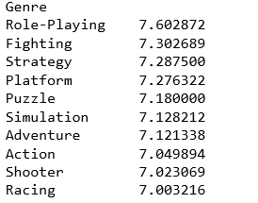
Game for Europe
Name: The Unforgiven
Style: Action
Platform: PS3
Publisher: Sony Computer Entertainment
ESRB Rating: M
Target user score: 7.05+

Slide 17

Game For North America

Slide 18
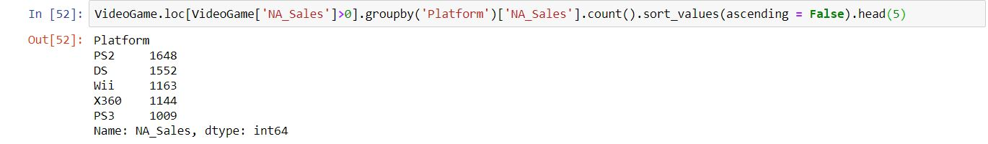
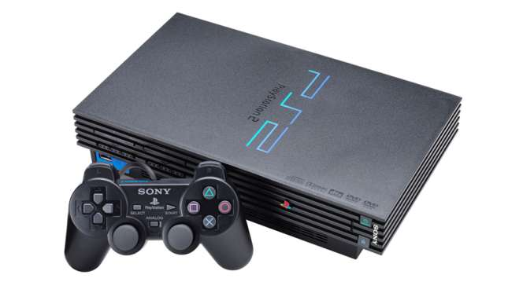
PLATFORM

Slide 19

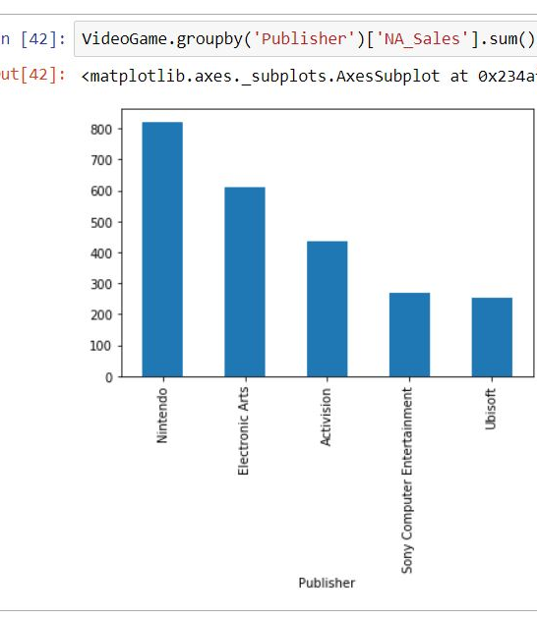
PUBLISHER

Slide 20

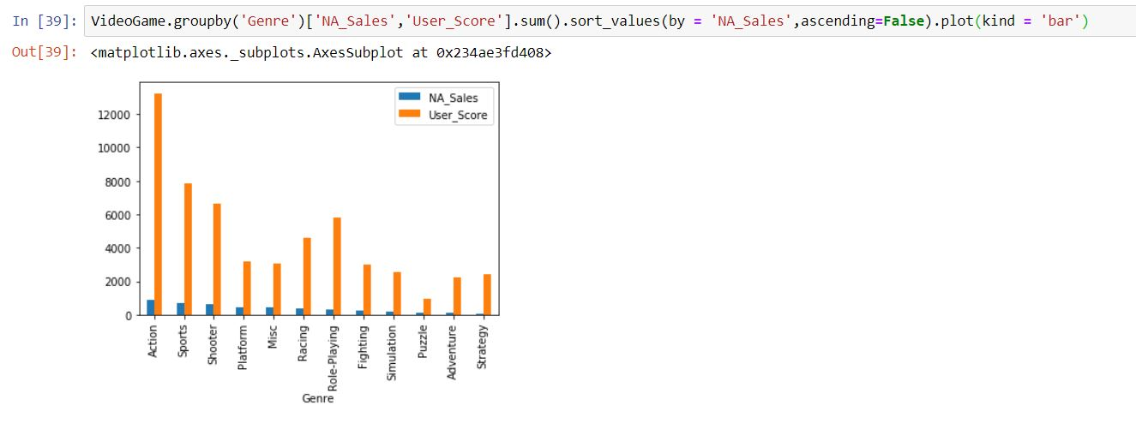
GENRE

Slide 21
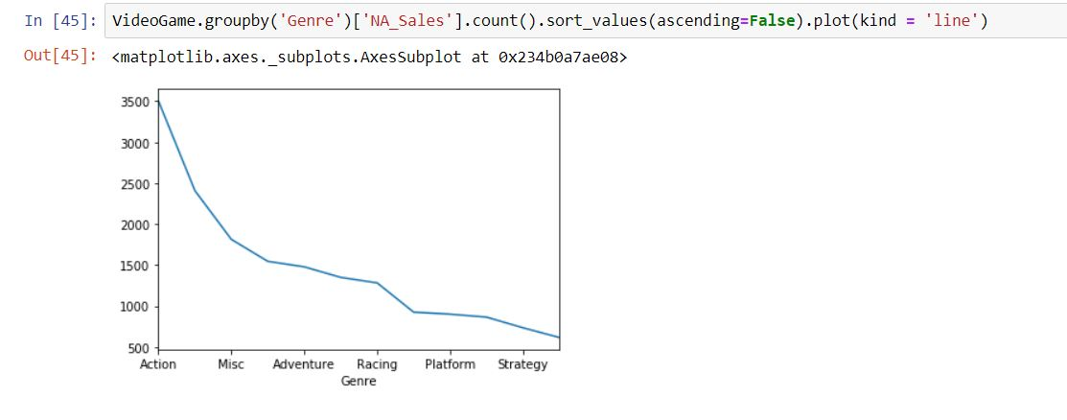
TOTAL NUMBER OF GAMES ON ACTION GENRE

Slide 22
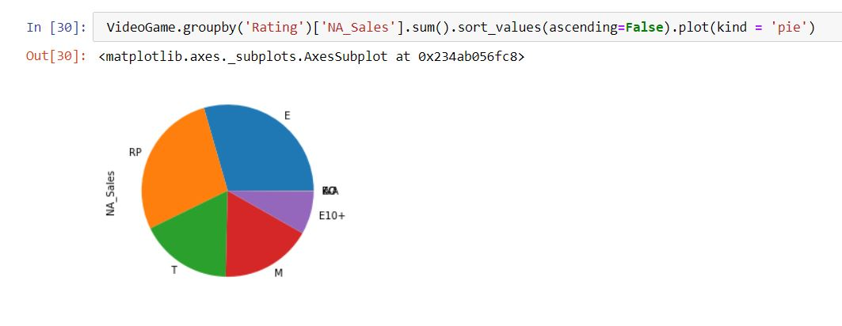

GAME CONTENT

Slide 23
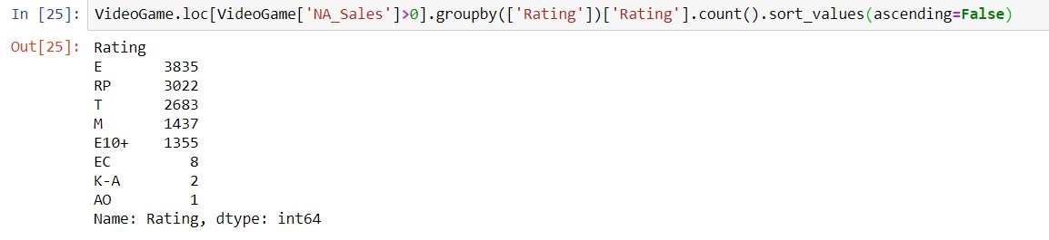

TOTAL NUMBER OF “E” CONTENT RATED GAMES IN NA REGION

Slide 24

Our game for North America is to produce an Action Game with “E” content on PS2 platform using EA Sports as publisher

Slide 25

We Are Here

